Slide 1
Instructions - Slide Content
<Note: Remove this first slide before presenting the brief. See Slide Notes for additional information>
Instructions:
  Text in <brackets and bold blue text> is instruction and should be removed prior to presenting the brief.
  Text in bold blue, without brackets, is an example of one way to complete the slide text and should be addressed, removed, or replaced prior to presenting the brief. Please change the added text back to black.
  See the Slide Notes supporting each individual slide.
  Slides do not need to be 100% completed for AO presentation.
  Apply applicable markings to the briefing as well as the Body of Evidence (BOE) in accordance with Program Security Classification Guide (SCG).
Notes:
This brief is an opportunity for the Program to provide the AO with an executive summary of the information system, its status, and any associated risks. The information provided within the document should address the following questions:
What is the System? What does it do? CONOPS? Missions?
What is the System Architecture? Weapon System (e.g., Aircraft, Ground Systems, Maintenance Systems, Training Systems, etc.)
List of Hardware (LRU), Software, and providence of each (e.g., supply chain); identification of Critical Program Information (CPI), Critical Components (CC); Technical Orders, and Operational Procedures. Identification of technologies being used.
Identification of all external communications access points.
How does data flow into, through, and out of the system? What type of data is it? How is it protected? Where does it come from? Where does it go? What is it used for?
What threat/intel information is available?
In addition to the system capability status, this brief must answer the following concerning supply chain risks:
Bill of Materials (BOM) - As part of the systems engineering (SE) process, especially in a legacy system, programs already know all parts (hardware and software).
Existing supplier management process identifies supplier source, End of Life (EOL) analysis, and alternate part analysis. (Document “As-Is”)
Existing criteria being used by primes and flowed down to subs, on purchasing of parts is known?
What is the supply chain mapping? Does one exist already?
With the data collected from items 1-4 above, review the potential risks of the supply chain
Provide available intel/threat info that can be applied against the list of parts or suppliers identified (or technologies)
Provide an assessment of the risk of the current supply chain
Provide a graphical representation of the supply chain

Slide 2
OVL Program Authorization Tag Up
SYSTEM/CAPABILITY NAME
Authorizing Official:
AODR:
CRA:
Program Manager:
ISSM:
eMass/Xacta record:
Date:
DISTRIBUTION STATEMENT A: Distribution approved for public release on 09 May 2025; distribution is unlimited.
Case Number: 25-T-2016
Notes:
Please add system name, PM, and date
This is the Program/Capability update to the Authorizing Official on the status of the Authorization: Conditions, ORTB, Risks, etc.
This is the Program Mangers briefing, to outline the status of the system/capability and update the AO on progress made, challenges, changes, future changes, etc.
This is a living view of the risk posture of the system/capability.
The main objective is to provide the CONMON relating to the authorization. The status of the system/capability from a cyber risk perspective and allows for the continuous assessing and authorizing approach to the OVL ecosystem.
At any point in time, this Program Tag Up briefing can be used to generate an AO Determination Briefing for an Authorization update, addition, change, reciprocity, etc.

Slide 3
Slide Change Log
Date:
  Slide #: Slide Title
Notes:
OPTIONAL
Please add the date and the slide number and title that have changed since the last tag up.

Slide 4
Table of Contents
Notes:
OPTIONAL
The agenda overview of this Tag up – as there are common elements to all Tag ups, but it’s also variable depending on the system type and state of the system.
Cloud vs DevSecOps vs Weapon System vs Enterprise system etc. Each have unique aspects to each as well as common aspects.

Slide 5
<Capability> Executive Overview (PEC:1/2)
Program Team
PM, < Name, Organization>
ISO, <Name, Organization>
ISSM, <Name, Organization>
ISSE, <Name, Organization>
Pen Test Lead, <Name, Organization>
Program Support, <Name, Organization>
AO and Support Team
AO, Mr. Daniel Holtzman, CDAO
AODR, <Name, Organization>
CRA, <Name, Organization>
Mission and System Description
<High-level system description. One or two sentences>
Operational Mission Support
<Include recent vignettes or hyperlinks of applicable operational mission support publications.>
Program
Assess and Authorize
Cyber
Team Sport

Slide 6
Mission and System Description
<In one paragraph, describe any additional details about the mission.>
<Provide a high-level description of the system. Include System Categorization and Classification Level. >

Slide 7
Cyber Security and Resiliency Enablers
The items below should be conveyed to the AO within this briefing; these slides are NOT to be filled out. Please remove this slide prior to submission.
<What is the System? What does it do? CONOPS? Missions?>
<What is the System Architecture? Weapon System (e.g., Aircraft, Ground Systems, Maintenance Systems, Training Systems, etc.)>
<List of Hardware (LRU), Software and providence of each (e.g., supply chain); identification of Critical Program Information (CPI), Critical Components (CC); Technical Orders, Operational Procedures. Identification of technologies being used.>
<Identification of all external communications access points.>
<How does data flow into, through, and out of the system? What type of data is it? How is it protected? Where does it come from? Where does it go? What is it used for?>
<What threat/intel information is available?>
This is the set of Enablers that should be addressed during the rest of the briefing
This chart can be moved to back up. it can be a pointer to the charts in the briefing that address the areas.
IT IS A TEMPLATE CHART – THE BRIEFING SHOULD ADDRESS THESE AREAS
Notes:
Reference only, remove slide before submission.
Reference NIST Special Publication 800-161
Identify your programs supply chain risks for the information system.

Slide 8
Supply Chain Risks
The items below should be conveyed to the AO within this briefing; these slides are NOT to be filled out. Please remove this slide prior to submission.
<Bill of Materials (BOM) - As part of the systems engineering (SE) process, especially in a legacy system, programs already know all parts (hardware and software).>
<Existing supplier management process identifies supplier source, End of Life (EOL) analysis, and alternate part analysis. (Document “As-Is”)>
<Existing criteria being used by primes and flowed down to subs, on purchasing of parts is known?>
<What is the supply chain mapping? Does one exist already?>
  <With the data collected from items 1-4 above, review the potential risks of the supply chain>
  <Provide available intel/threat info that can be applied against the list of parts or suppliers identified (or technologies)>
  <Provide an assessment of risk of the current supply chain>
  <Provide a graphical representation of the supply chain>
This is the set of Enablers that should be addressed during the rest of the briefing
This chart can be moved to back up. it can be a pointer to the charts in the briefing that address the areas.
IT IS A TEMPLATE CHART – THE BRIEFING SHOULD ADDRESS THESE AREAS
Notes:
Reference only, remove slide before submission.
Reference NIST Special Publication 800-161
Identify your programs supply chain risks for the information system.

Slide 9
System Architecture
EXAMPLE
  <Add high level system description here.>
  The architecture diagram describes the system architecture – how things work, the parts or sub parts of the system
Notes:
Reference Only…replace architecture
This is the level of detail that is needed.
The system architecture should show the AO what the architecture is, physical location, encryption, interfaces and protocols, physical and technical protection mechanisms, vendor access, etc.
A system architecture is the conceptual model that defines the structure, behavior, and views of a system. An architecture description is a formal description and representation of a system, organized in a way that supports reasoning about the structures and behaviors of the system. Identify the architecture, locations, encryption, interfaces, protocols, physical and technical protection measures, vendor access, etc.

Slide 10
Interconnection(s)/Interface(s)
Represents External Interfaces/AO Boundaries
EXAMPLE
Identify all interfaces, data flows, connections in/out of the authorization boundary.
Every interface represents a connection to another system/capability and AO boundary that needs to be addressed.
Notes:
Reference Only…replace architecture
Describe the interconnections/data flows this system has with any external systems or networks. Describe what the external connections are: PITIs, other external connections, standalone systems, etc.
This is the level of detail on the communications needed – all in/out links
This is reused from the determination briefing and updated

Slide 11
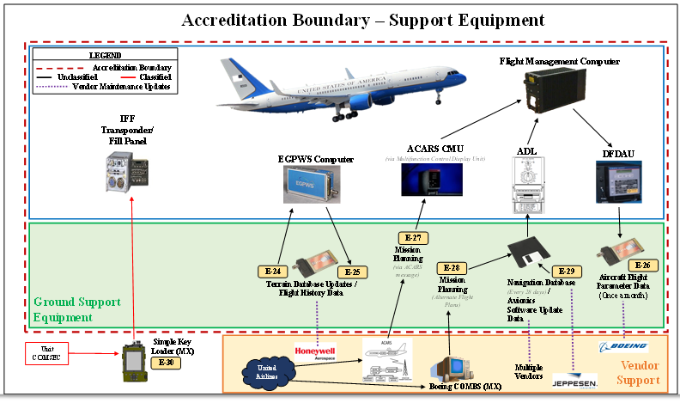
Authorization Boundary
EXAMPLE
The Red dashed box in this example is showing the boundary of the authorization. Everything inside the Red dashed box is part of the authorization. ALL connections and data flows in/out of the red dashed box represent areas that require being addressed as connections and data flows in/out of the authorization boundary
Notes:
Reference Only…replace architecture
The authorization boundary diagram must specifically identify what is included in the boundary. The AO risk acceptance determination will be strictly based on threat/vulnerability pairs identified within the specific boundary.
The main purpose of this chart is an example of WHAT is in the boundary of the Authorization that the AO is being asked to assess and make a determination on. As shown by the RED dashed line (see the legend). What is IN the boundary of the authorization, and what is EXTERNAL to the boundary of the authorization. This chart is an example of an “Airplane Weapon system” boundary.

Slide 12
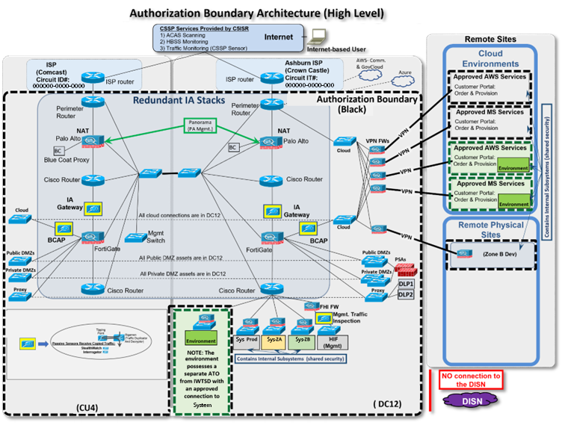
SYSTEM NAME Authorization Boundary
EXAMPLE
EXAMPLE of a cloud-based system authorization boundary
Notes:
Reference Only…replace authorization boundary
This shows what is authorized.
It should have a ledged and be standard across all Tag Up briefings
For example – this chart shows TWO authorizations, one in black dashed one in green dashed
This should show the AO what is under authorization. It should have a very clear line or box around the area that is within the ATO. The AO is responsible for, with a key on the chart so that its easily understood. This chart should be same as in the AO determination briefing (or should be at that point in time, and then we monitor change from that point forward).

Slide 13
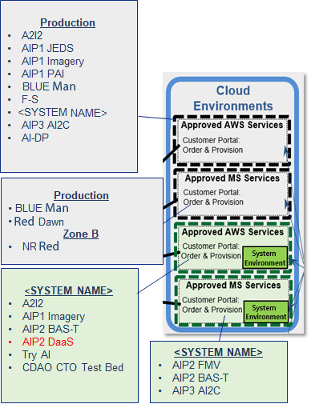
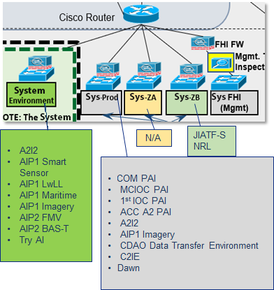
Mission Partners in SYSTEM NAME
As of Date
On Premises
Cloud
EXAMPLES
EXAMPLE of a cloud-based system authorization boundary
Notes:
Reference Only…replace Mission Partners
In this case, this program shows a second chart to outline the workloads within the system.
Note that this is a second authorization boundary chart, in more detail.
It’s the Operational view – how the capability the 18 different workloads inside the capability.
The various cloud zones of the capability (e.g. prod, ZA, ZB, etc.). This gives the AO and team an understanding of the “how” the capability being authorized is being used.

Slide 14
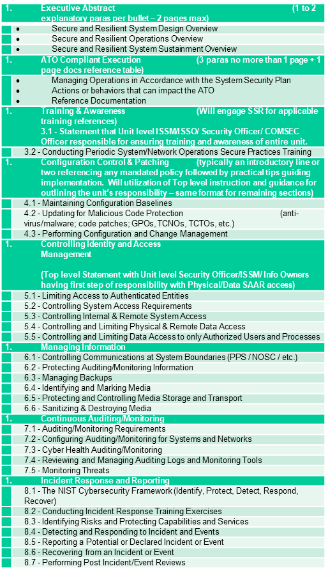
Cyber Tech Order and Continuous Monitoring
Provide the status and location of the items listed in the table to the right.
Cyber Tech Order:
Communicate the “How” to maintain systems for Secure Resiliency.
Provide clear operating instructions for users and maintainers.
Educate, enable, and execute.
Continuous Monitoring:
Recognize that change is constant.
  New vulnerabilities and threats appear every day.
  Technology changes.
  Mitigation effectiveness degrades over time.
Outline ALL cyber related process for the system/capability.
These represent the set of instructions/process that are used to sustain the system authorization, to have the CONMON and insight into the system risk posture.
Notes:
This is reused from the determination briefing and updated.
The objective of this is to document the program’s processes.
This is a KEY part of continuous assessing, monitoring, and authorizing.

Slide 15
Cyber Tag-Up Rhythm
Proposed Schedule – For Discussion
<List any information on the focus of specific Tag Ups>
Cyber Tag-Up Rhythm | FY23 Q3 |  |  | FY23 Q4 |  |  | FY24 Q1 |  |  | FY24 Q2
JSF Cyber Tag-Up Rhythm | Apr | May | Jun | Jul | Aug | Sep | Oct | Nov | Dec | Jan | Feb | Mar
Audience:
*Scheduled AO Tag-Ups are to occur quarterly with escalations to the AO occurring as needed.
**Cadence of AO Deep-Dives will be dictated by the conditions outlined in the specific environment’s authorization.
Notes:
This shows the program cadence.
The intent is to show who is communicating with whom.
Each system has different stakeholders, so this provides to big picture view
It might include other AOs, or DCSA, or users, or other stakeholders for example
*Keep Mr. Holtzman CC’d on meetings with Greg Little and Joe Larson for situation awareness

Slide 16
Authorization Tracker
# | System Name | Boundary | Impact Level | Authorization Decision | Residual Risk level | Authorization Expires
 | Current Authorizations
 | SYSTEM NAME
 | SYSTEM NAME
 | (Potential) Future Authorizations
 | Authorizations of Interest
Notes:
This shows the authorizations associated with this program/capability.
The audience is the CDAO AO, other AOs, etc. who need to see the whole picture

Slide 17
SYSTEM NAME North Star
2023 Objective State
# | Objectives | Status | Comments
Objective met
Objective partially-met
Objective not met
Notes:
This shows what the vision is for this effort, near, and long term.
This is the PROGRAM NORTHSTAR
Relating to cyber security specific but can be larger.
Providing the big picture allows context, to see where the program is going, to better align the authorization strategy to the acquisition strategy.

Slide 18
AO Dashboard (1/3)
SYSTEM NAME - Overview
Provide a high-level description of the system. Include high level architecture diagram/view, System Categorization and Classification Level.
AO Dashboard Back up charts. These Three charts are provided to leadership when asked about any authorization.
These should show the current Status relating the cyber risk posture.
Notes:
This should be high level one chart view of what the system/capability is – provided to a senior leader to give them a view of what this system/capability is/for and does.

Slide 19

<Capability> – Authorization Status (PEC:2/2)
Authorization Status
Challenges/Big Rocks
System | CIA | ATO Status | ATD | Auth Trend
<SYSTEM NAME>
<SYSTEM NAME>
Past 90 Days
Next 90 Days
AO Dashboard Back up charts. These Three charts are provided to leadership when asked about any authorization.
These should show the current Status relating the cyber risk posture.
Notes:
This is the high-level summary Dashboard view of the program/effort/capability. It’s what the ISSM/CRA should work in partnership and provide as part of the bi-weekly cyber tag up (they are in the backup charts), so the AO has a quad chart view of every effort in the boundary for reference. This is also a chart that would go up the channel to leadership if a question is asked on the status. Given the authorization tracker is sent up monthly, questions will start to be asked. This is one of the charts that will provide a BLUF update view.

Slide 20
AO Dashboard (3/3)
SYSTEM NAME - Schedule Dashboard
Project management schedule plan with defined milestones
Related to the cyber posture
FY23 Q4* | FY24 Q1
FY24 Q2 | FY24 Q3
AO Dashboard Back up charts. These Three charts are provided to leadership when asked about any authorization.
These should show the current Status relating the cyber risk posture.
*Or the current fiscal quarter
Notes:
This provides the AO and team a view of the next year, what are the events coming up? What events of the current or past quarter have been accomplished?
This is a second AO Dashboard chart (companion to chart 4 above). These two give a good high-level overview of the current state of the security posture, what is being done currently to make things more secure today, and what is planned to make things more secure tomorrow. In combination, they provide a high-level overview of the status and plans for the program.
When there is a program that might be trending yellow or red, these two charts would be the first things leadership will see – why? What is being done to correct this? If we have been working things effectively these two charts will highlight that info.

Slide 21
SYSTEM NAME Action Item Look ahead
30 Days
60 Days
90 Days
120+ Days
90 day
This represents the action item look ahead.
All actions should be identified 120 days out, and monitored as they get closer.
The objective is to be proactive, to identify things in advance and work them to closure BEFORE the 30-day window.
Notes:
This is NOT an IMS, it’s a look-ahead dashboard.
The AO needs to see what is coming that needs to be addressed so the team can be proactive. And track until closed.

Slide 22
System Focus: SYSTEM NAME
Authorization Conditions Status
# | Conditions | Date | Status
LEGEND
G = Condition satisfied | Y = Condition partially-satisfied | R = Condition not satisfied | = On path to meet
Notes:
This is the primary focus of the program Tag ups – where are things based on the ATO conditions? What does “done” look like? What are the next set of things in the queue?

Slide 23
System Focus: SYSTEM NAME
Conditions Breakdown
Authorization To Operate With Conditions (ATO-C):
  SYSTEM NAME 35P21.Q4 ATO-C Signed out on July 31, 2023, ATD June 30, 2024.
Eight Primary Conditions – Jun 2024 ATO-C Re-Authorization:
Feb-2022-3 – Service ATC Condition Addition (Partially Satisfied - ongoing work).
  DCI and Mx Sys will work with the service POCs to align efforts to complete this condition.
  Efforts will focus on how to get this condition to green and ensure proper configuration management is achieved at all sites:
    Needs to be done via the service reps.
    Need a service level lead to assist with this.
  Must get dates for when each site will provide input to the HW/SW configuration management efforts.
    DCI is requesting access to this information.
Feb-2022-4 – CS&D CSSP Working Group (Satisfied):
  DCI will work with Mx Sys to determine what a CSSP will do for a weapons system.
    CYBERCOM has developed the overall tasks and should be leveraged by the SYSTEM NAME team.
    SYSTEM NAME team will determine what subset of tasks belongs to the Program.
    Need to focus discussion on what are the tier (Tier I, II, III) responsibilities:
      The AO will form a larger working group to drive additional CSSP efforts.
  SYSTEM NAME should only need to generate data that the service can ingest to support their CONMON efforts.
    SYSTEM NAME should not drive how that data is displayed or correlated.
Feb-2022-5 – ALOU Contingency Plan strategy update (Satisfied):
  Step 1 – Determine if the existing ALOU CP captures the process sufficiently (in progress).
    The CP requires updates to reflect recent remote access needs for administrators.
  Step 2 – Take a look at each of the major types of situations that an ALOU that is unavailable will impact.
    Scenario 1 – The squadron is at their home site and is running sorties.
    Scenario 2 – The squadron is afloat.
    Scenario 3 – The squadron is abroad.
  Need to document each of the scenarios and develop the contingency plan for each.
EXAMPLE
Notes:
Backup chart for the previous, with more detail on each condition. This could be from the tracker spread sheet also.
NOTE: Example from F-35 of condition status back up chart. These are more for the CRA/ISSM and team to drill down to make sure everyone is on board with what does “done” look like for each condition? How do we know it’s turned to green? Does it turn back to yellow if something happens? Etc.
Note 2: There needs to be a way to define what done looks like for each condition as there are many views on that, and we might need to be more specific when we write them originally.

Slide 24
CDAO ORTB (1/2)
(Organizational Risk Tolerance Baseline)
1. Account Management (Aligns to ORTB: AC-2) Monitor and Enforce user and group account creation/deletion 2. Administrative Privileged Accounts (Aligns to ORTB: AC-6) Privileged user/service accounts are only authorized to perform security relevant functions. Review and approve annually. 3. Audit Review, Analysis, and Reporting (Aligns to ORTB: AU-6) Review and analyze Information System (IS) audit logs for indications of inappropriate or unusual activity and reports findings to designated personnel IAW IRP 4. Boundary Protection (Aligns to ORTB: SC-7) Monitors and controls communications at the external boundary of the system and at key internal boundaries within the system 5. Continuous Monitoring (Aligns to ORTB: CA-7) System level monitoring metrics, including control monitoring frequencies, are defined by the organization and approved by the AO 6. Data Integrity (Aligns to ORTB: SI-7) Employ automated tools to report system (hw/sw/fw) and information (data) integrity violations. Ensure automatic integrity validation of all electronically transmitted software and data 7. External Connections (Aligns to ORTB: CA-3) Agreement/authorization used to approve external connections and manage the exchange of information should be defined (ATC, ISA, CSA, ICD, etc.) and reviewed annually 8. External Media (Aligns to ORTB: AC-4, MP-7) If authorized, place configuration control process on all external media including auditing. Institute external media whitelisting. Implement processes to monitor logs and audit usages. 9. Information Flow Enforcement (Aligns to ORTB: AC-4) The information system enforces approved connections for controlling the flow of information within the system and between interconnected systems | 10. Least Privilege (Aligns to ORTB: AC-6) Reviews, at least annually, the privileges assigned to privileged user accounts including Designated Transfer Agent and Trusted Cloud Credential Manager roles 11. Operational Change Mgmt (Aligns to ORTB: CM-8, CM-8(3), SI-7) Automated mechanisms shall be used to detect the presence of unauthorized hardware/software/firmware within the system. One or more of the following action shall be taken upon discovery of unauthorized components: disable network access by unauthorized components; isolate unauthorized components; notify designated personnel identified in IRP 12. Proposed Equipment (Aligns to ORTB: SA-22 – applies to C.I.A. impact High on non-SAP systems, CM-3) Lock down all mission support systems and migrate off unsupported operating systems. Review support agreements (hw/sw/fw) annually 13. Protection of Information at Rest (Aligns to ORTB: SC-28, SC-28(1)) Encryption is implemented to complement protection of information at rest, using approved cryptographic methods for data encryption 14. Secure Baseline Configuration (Aligns to ORTB: CM-2, CM-6) This Information System's secure configuration includes DoD Security Technical Implementation Guides or industry best practices and verified conformance prior to introduction into production or operational environments 15. Security Categorization (Aligns to ORTB: RA-2) Enforce proper security categorization and review annually 16. Separation of Duties (Aligns to ORTB: AC-5) Separates defined duties of individuals and documents separation of duties of individuals 17. Vulnerability / Anti-Virus Scanning (Aligns to ORTB: RA-5) Conduct routine anti-virus scans on traditional IT systems and hosted applications. Institute continuous monitoring protection on all IT systems to include maintenance and testing support systems
*Red font indicates specific JSIG, Non-Tailorable controls
Foundational ORTB

Slide 25
CDAO ORTB – AI View (2/2)
(Organizational Risk Tolerance Baseline)
Cyber risks for AI are not new. AI risks are inherently covered by the CDAO ORTB. Each of the AI-Specific Views below tie back to multiple ORTB risks numbers noted on slide 1 of 2.
AI Foundation (Aligns to CDAO ORTB: 4/5/6/13/17) Encrypt any stored AI-related data and models Regularly patch AI components (hardware and software) on known vulnerabilities and update threat definitions Account for vetting of AI supply chain Data Integrity (Aligns to CDAO ORTB: 4/6/9/11/17) Depict provenance and lineage of datasets used for training models Implement mechanisms that ensures the integrity and authenticity of ingested data against adversarial attacks. Ensure privacy of personal data, anonymizing information where necessary Establish data retention and disposal mechanisms Model Management (Aligns to CDAO ORTB: 3/4/11/17) Depict architecture, justification, and rationale for the selection of a specific model Establish regular evaluation and validation procedures of training models Ensure rollback mechanism for models, configurations, and training data | Operational Resilience (Aligns to CDAO ORTB: 3/5/14/17) Regularly employ red teaming testing methodologies and maintain logs of outcomes Continuously monitor system performance metrics against predefined benchmarks or thresholds for validation User Interaction (Aligns to CDAO ORTB: 1/2/10/16) Incorporate mechanisms for users or other stakeholders to provide feedback on model output Implement oversight on user interactions, including data input, queries, and code base changes Responsible Accountability (Aligns to CDAO ORTB: NEW) Implement tools and/or methodologies that can elucidate model decisions Implement DoD Responsable AI (RAI) Principles
*Green font indicates Linkage back to CDAO ORTB
Foundational ORTB

Slide 26
Cyber Hygiene Areas
AO Emphasis (CDAO ORTB)
Account Management (AC-2)
Common Program – Inherited: The Program ensures account management procedures and activities are performed in accordance with baseline information security requirements. Common Site – Inherited: The local site hosting SYSTEM NAME will ensure the Information Systems Security Manager (ISSM)/Information Systems Security Officer (ISSO) implement account management policies and procedures per the standard operating procedure (SOP) provided.
Administrative Privileged Accounts (AC-6)
Common Site – Inherited: The local site hosting SYSTEM NAME establishes organizational policy, processes and procedures to ensure the principle of least privilege is implemented. System Specific – Implemented: The principle of least privilege is implemented in the SYSTEM NAME system with standard and privileged accounts. Privileged accounts require local ISSO and PSO approval before the account is created.
EXAMPLE
Notes:
This is the Back up for the Hygiene areas
EXAMPLE
REFERENCES (AC-2):
1. SYSTEM NAME ALOU Standard Operating Procedures (SOP) DNPP6052 35P21.Q2 > 4.2 System User Access Policy
2. SYSTEM NAME Information System Owner (ISO) Standard Operating Procedures (SOP)
3. SYSTEM NAME Site Assessment Procedures (SAP) Workbook
4. SYSTEM NAME Standard Operating Procedures (SOP) DNPP6075 35P21.Q2 > 4.2 System User Access Policy
5. SYSTEM NAME System Security Plan DNPP6039 35P21.Q2 > 3.3 Personnel Authorizations
6. SYSTEM NAME System Security Plan REL DNPP6044 35P21.Q2 > 3.3 Personnel Authorizations
Admins at Sites are noted to have excessive privilege and access to various functions within the system
REFERENCES (AC-6):
1. SYSTEM NAME ALOU Media Transfer Procedures Appendix US Only DNPP6049 35P21.Q2 > 2 Data Transfer Agent (DTA)
2. SYSTEM NAME ALOU Standard Operating Procedures (SOP) DNPP6052 35P21.Q2 > 2 SECURITY OVERVIEW
3. SYSTEM NAME Standard Operating Procedures (SOP) DNPP6075 35P21.Q2 > 2 SECURITY OVERVIEW
REFERENCES (AU-6):
1. SYSTEM NAME ALOU Standard Operating Procedures (SOP) DNPP6052 35P21.Q2 > 5.3.4 Audit Review
2. SYSTEM NAME Information System Owner (ISO) Standard Operating Procedures (SOP)
3. SYSTEM NAME Security Audit Guide DNPP6074 35P21.Q2
4. SYSTEM NAME Site Assessment Procedures (SAP) Workbook
5. SYSTEM NAME Standard Operating Procedures (SOP) DNPP6075 35P21.Q2 > 5.3.4 Audit Review

Slide 27
Cyber Hygiene Areas
AO Emphasis (CDAO ORTB)
Continuous Monitoring (CA-7)
Common Program – Inherited (Open): The Program establishes organizational policy, processes and procedures to ensure a continuous monitoring strategy is implemented at each site that hosts SYSTEM NAME. Common Site – Inherited: The Continuous Monitoring frequencies are documented in the SYSTEM NAME SCTM. In coordination with the Program, the local site will ensure security control assessments and monitoring tasks are completed and reported in accordance with F-35 PD 105.0. The local site will perform an analysis of security-related information generated by assessments and monitoring. SYSTEM NAME completes ACAS scans of the entire environment. Scan data is analyzed in Security Center. STIG updates are processed quarterly as they are released. Results of STIG checks and Nessus scans are documented and issues addressed. The Continuous Monitoring metrics established above are reported to the local ISSO, System Administrators, and the Program.
Data Integrity (SI-7)
Common Program – Inherited (Partial): The Program ensures policy regarding integrity verification tools to detect unauthorized changes to software in information system components is documented. System Specific – Implemented: SYSTEM NAME employs McAfee Policy Auditor, ARC, and Solidcore to detect unauthorized changes.
EXAMPLE
Notes:
This is the Back up for the Hygiene areas
EXAMPLE
REFERENCES (CA-7):
1. SYSTEM NAME Continuous Monitoring Plan
2. SYSTEM NAME Information System Owner (ISO) Standard Operating Procedures (SOP)
3. SYSTEM NAME Site Assessment Procedures (SAP) Workbook
Currently relying on local sites to support with ConMon activities.
REFERENCES (SI-7):
1. SYSTEM NAME Information System Owner (ISO) Standard Operating Procedures (SOP)
2. SYSTEM NAME System Security Administration Guide DNPP6076 35P21.Q2 > 23.2.15 Policy Auditor and System Monitoring
At this moment, there are no automated tools deployed to perform any validation of all electronically transmitted software and data.

Slide 28
Cyber Hygiene Areas
AO Emphasis (CDAO ORTB)
External Connections (Aligns to ORTB: CA-3)
Common Program – Inherited: The Program establishes organizational policy, processes, and procedures to ensure the interconnection security agreements are managed properly. Common Site – Inherited: The local sites hosting SYSTEM NAME will be required to establish an Authority to Connect (ATC) for any required connections and will review/update any interconnection security agreements at least annually. The local site hosting SYSTEM NAME will document each interconnection through an Authority to Connect (ATC) agreement.
External Media (Aligns to ORTB: AC-4, MP-7)
Common Program – Inherited: The Program establishes organizational policy, processes, and procedures to restrict the use of digital and non-digital media and portable storage and mobile devices with information storage capability. Common Site – Inherited: SYSTEM NAME prohibits the use of unauthorized hardware or software. The local site hosting SYSTEM NAME only allows approved media to be connected and associated media control procedures must be followed. System Specific – Partial: Information flow will only be across defined boundaries as identified within the System Security Plan (SSP). All Assured File Transfers (AFTs) must be documented unless the transfer originates from an unclassified system. All media must be virus scanned prior to starting an Assured File Transfer (AFT) and again prior to introduction into the target system. Media must be tested to ensure it is write-protected on the high-side system. If the media fails, it must be protected to the higher classification level. Information flow is also enforced via Access Control Lists (ACLs) and Firewall rule sets. Port security, policy filters, and network rulesets are configured in accordance with applicable DOD STIGs.
EXAMPLE
Notes:
This is the Back up for the Hygiene areas
EXAMPLE
REFERENCES (CA-3):
1. SYSTEM NAME Information System Owner (ISO) Standard Operating Procedures (SOP)
2. SYSTEM NAME Site Assessment Procedures (SAP) Workbook
REFERENCES (MP-7):
1. SYSTEM NAME Information System Owner (ISO) Standard Operating Procedures (SOP)
2. SYSTEM NAME Site Assessment Procedures (SAP) Workbook"
AC-4 – Partial due to STIG findings

Slide 29
Cyber Test Schedule
System Name | Testing Entity | SYSTEM NAME Environment | Status | Start Date | End Data
Identify all cyber related testing that provides insight in the risk posture
Notes:
NOTE: Larger than just pen test view. More overall testing view.

Slide 30
PenTest Schedule
<Provide stakeholder agreed upon Testing Schedule in support of this specific effort.>
  Pen Test Playbook (Vendor Dependent).
<Insert Schedule>
  <If testing has been completed, provide results via appropriate channels.>
•
•
•
System Name | Environment | Status | Start Date | End Date
•
•
•
Program
Persistent Pen Testing is key to having continuous CONMON
Notes:
This chart and the next chart will show what pen tests or other tests are planned and when. There is a holistic site picture.
Could also be augmented by a traditional schedule view
Provide stakeholder agreed upon Testing Schedule in support of this specific effort
If testing has been completed, provide results via appropriate channels.>
Please see NIST SP 800-115, Technical Guide to Information Security Testing and Assessment
A penetration test, aka known as a “Pen test” or “Ethical Hacking”, is an authorized simulated cyberattack on an Information System, performed to evaluate the security state of the system.
Pen testing is an augmentation to the overall risk assessment and continuous monitoring. Not stand-alone or separate but augmented.
Coordinate and schedule with your contracted Pen testing team to ensure that you are getting your Information System Pen testing accomplished and the findings of the Pen test are published to the organization that are submitted up as part of the Authorizing Officials required Body of Evidence.
Penetration testing usually relies on performing both network port/service identification and vulnerability scanning to identify hosts and services that may be targets for future penetration. Also, multiple technical ways exist to meet an assessment requirement, such as determining whether patches have been applied properly.

Slide 31
SYSTEM NAME CVPA/AA Out-Brief
AO Out-Brief:
  48th CTS will finalize the report (30 days) and deliver to the Program and DOT&E for review:
    Looking to lock in tentative date.
  UOTT working with stakeholders to lock in date.
Testing Recap:
  CVPA Completed for Test 1, Test 2, Test 3.
    CPE, SOU, and ALOU:
      CPE-U, CPE-C, ALOU-U, ALOU-C, SOU-U, SOU-C, and ESU tested to date.
    CPE Test Completed at Eglin AFB.
    ALOU Test Completed at LM FTW.
    SOU Test Completed at Eglin AFB.
  CVPA Test Results (Pending Final Report):
    CPE – 7 CAT I Findings.
    ALOU – 4 CAT I Findings.
    SOU – Pending Out-Brief.
EXAMPLE
Post test out-brief to capture results and areas to address. adds information to be correlated and integrated into the existing risk posture analysis.
NOTE: the AO analysis of risk posture integrates all views of others into a single site view of risk and priorities.
Notes:
For any tests that were conducted in the period of the briefing, a report would be provided.
NOTE: example from F-35 – results of any pen tests would go here.

Slide 32
Cyber Big Rocks
Subject | Description | POC | Status | Next Steps
Start slow; move fast.
Notes:
What are the big challenges the program must deal with coming up? Things that might take help?

Slide 33


Risk Scale Summary
R1 – Initial Risk Level
R1* – Residual Risk Level
LEVEL OF IMPACT
 | VERY LOW | LOW | MODERATE | HIGH | VERY HIGH
VERY HIGH | Very Low | Low | Moderate | High | Very High
HIGH | Very Low | Low | Moderate | High | Very High
MODERATE | Very Low | Low | Moderate | Moderate | High
LOW | Very Low | Low | Low | Low | Moderate
VERY LOW | Very Low | Very Low | Low | Low | Low
EXAMPLE
LIKELIHOOD
R2*
R2
R1
R3
R1*
R3*
Notes:
Reference Only, replace with your programs Risk Scale Summary diagram.
This table is from the DoD Risk Assessment Guide based on NIST SP 800-30, but reference NIST SP 800-39, Managing Information Security Risk to determine Level of Impact..
COMMUNICATE RISK ASSESSMENT RESULTS - TASK 3-1: Communicate risk assessment results to organizational decision makers to support risk responses.

Slide 34
Risk Analysis Report
Risk # R1 | Area of Concern (xxx) | Mechanisms (xxx) | Initial Risk Level (xxx)
Threat: <Describe the specific threat/threats that can potentially exploit this vulnerability.>
Vulnerability: <Describe the vulnerability.>
Likelihood: <What is the likelihood? Describe the likelihood of the vulnerability being exploited. Use means and opportunity.>
Impact: <What is the impact? Describe the impact of the vulnerability being exploited. Use criticality and impact.>
Mitigations In Place: <Describe the mitigations already in place.>
ADDITIONAL MEASURES APPLIED TO THE SYSTEM
Countermeasures Added: <Describe additional mitigations to lower the likelihood or impact of this vulnerability being exploited.>
Residual Risk: <If mitigations in place and or added countermeasures lowered the likelihood or impact, then the residual risk level could be lowered.> |  |  | Residual Risk (xxx)
Additional Countermeasures Suggested: <What further actions will be taken to reduce likelihood/impact in the future?>
Notes:
Reference Only, replace with your programs Risk Analysis Report.
Reference NIST SP 800-30 Rev1
The process of identifying, estimating, and prioritizing risks to organizational operations (including mission, functions, image, reputation), organizational assets, individuals, other organizations, and the Nation, resulting from the operation of an information system. Part of risk management, incorporates threat and vulnerability analyses, and considers mitigations provided by security risks planned or in place. Synonymous with risk analysis.

Slide 35
Mitigating Factors
Mitigating factors that reduce finding/risk:
  <Describe operational, management, and technical findings:>
    Standalone with limited access.
    Armed guards providing 24x7 physical protection.
    CD/DVD media is scanned and approved by IAO prior to being introduced to the system.
    Users are trained regularly and are aware of impact if unauthorized media is introduced to system; only IAO is allowed to introduce media.
Notes:
Re-used from the determination briefing and updated based on the previous risk chart.
Now that risks have been identified, please explain how to mitigate each of the findings.
Refer to NIST SP 800-39, Managing Information Security Risk
(i.e. Scan Results, Penetration Test Findings, PPSM)

Slide 36
Summary
<This is the summary the PM wants to convey to the AO on the system/capability status>
Notes:
This is the summary template chart.
The intent is a program would add its own summary here.
NOTE: this is not the AO summary template chart – need programs to add their own summary.

Slide 37

Questions?

Slide 38
Backup Slides
Notes:
MISC data / info

Slide 39
Cybersecurity Service Provider (CSSP) or Equivalent Services
<Identify your organization’s Certified CSSP or how you are addressing your CSSP equivalent services.>
  What is your program on contract for with the certified CSSP?
  What are the details of the SLA?
  If no Certified CSSP provider:
    Do you plan to obtain a CSSP provider?
    How is your program planning to meet/execute these services?
    Do you need assistance with obtaining a CSSP?
  How are you meeting the Mission Owner CSSP responsibilities (this is independent of the Certified CSSP responsibilities)?
Notes:
If you are providing your own services, please explain what services are being conducted and please include what DoD support has been approved or needed.
Per DoD Mandate 17-0019, DoDI 8530.01 you need a Cybersecurity Service Provider (CSSP), or your organization needs to be able to support similar services that meet the DoD requirements. CSSP are required for both on premises and cloud Information Systems. Establish Cyber Defense (CD) services through one of the 23 DoD certified Cyber Security Service Providers (CSSP) for Mission Cyber Defense (MCD)

Slide 40
Equivalent CSSP Services
CSSP services include but are not limited to:
  External Vulnerability Scans (EVS)
  Web Vulnerability Scanning (WVS)
  Malware Notification Protection (MNP)
  Support and Training (S&T)
  Network Security Monitoring (NSM)
  Attack Sensing & Warning (ASW)
  Warning Intelligence (WI)
  Incident Reporting (IR)
  Incident response Support (IRS)
    Volatile Data Analysis (VDA)
    Forensic Media Analysis (FMA)
    Reverse Engineering and Malware Analysis (RE/MA)
    Cyber Hunt/Intrusion Assessment (IA)
    Incident Response (IR)
  Sustainment & Configuration Management (SCM)
  HBSS or DoD approved equivalent Anti-Virus
  Port Whitelisting through DISA
<Note: Remove this slide prior to presenting brief.>

Slide 41
SYSTEM NAME Encryption Algorithms Summary
Connections | Details | SYSTEM NAME Encryption Algorithms
Notes:
Having a summary of the encryption used in the system is becoming more important. Also a summary of CDS and status.

Slide 42
Bottoms Up Assessment
Schedule as of DATE
Task Name | Start Date | Finish Date | Status
  Assessment Support Team:
  Name, CRA SYSTEM NAME.
  Name, Lead CRA.
  Name, Role, CDAO, Security Engineer (if applicable).

Slide 43
Bottoms Up Assessment
Progress since 22 AUG 23
Technical Deep Dives Completed
Questionnaires Received
Deep Dive Topic | Dates
Mission Partner
Questionnaires In Progress
Mission Partner
Mission Partner Deep Dives Completed
Mission Partner | Dates

Slide 44
SYSTEM NAME Change Management
Highlights – Date
CCB/CR | Description | Classification | Notes

Slide 45
Mitigating Factors – CCB-630
Mitigating factors that reduce finding/risk:
No access to CUI data.
Standardized deployment methodology.
Hardened Zone B infrastructure.
<SYSTEM NAME> Enterprise Defense in Depth with scanning, logging, and SOC monitoring.
EXAMPLE
Notes:
You’ve identified the risks, please explain how to mitigate each of the findings.
Refer to NIST SP 800-39, Managing Information Security Risk
(i.e. Scan Results, Penetration Test Findings, PPSM)

Slide 46
Security Impact CCB-628
CCB-628 – A2I2_Upgrade_Nutanix (from v5.20.2.1 to v6.5.3.1)_Production.
Description: Nutanix was authorized by CCB-282 and was installed in the <SYSTEM NAME> production on-premise A2I2 enclave to enable integrated management of the A2I2 Citrix deployment for more rapid provisioning of desktops, along with the ability to support multiple hypervisors, improve performance, and reduce total cost of ownership.
Change – Major OS upgrade of Nutanix AOS from version 5.20.2.1 to version 6.5.3.1.
Supporting Documentation: One Pager, TM Concurrence, Architecture Diagram, CONOPS, Release Notes, SI-M Memo.
Residual Risk – Low.
EXAMPLE
Notes:
Reference Only…replace architecture
The authorization boundary diagram must specifically identify what is included in the boundary. The AO risk acceptance determination will be strictly based on threat/vulnerability pairs identified within the specific boundary.

Slide 47
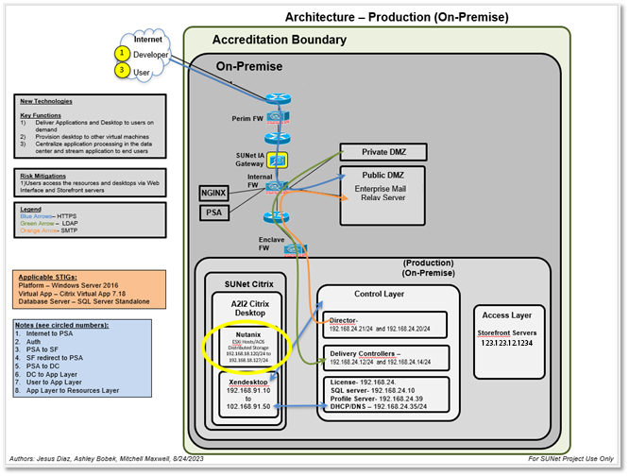
Security Impact CCB-123
EXAMPLE
Notes:
Reference Only…replace architecture
The authorization boundary diagram must specifically identify what is included in the boundary. The AO risk acceptance determination will be strictly based on threat/vulnerability pairs identified within the specific boundary.

Slide 48
Risk Analysis Report – CCB-#
Risk # | Area of Concern | Mechanisms | Initial Risk Level
Threat:
Vulnerability:
Likelihood:
Impact:
Mitigations In Place:
ADDITIONAL MEASURES APPLIED TO THE SYSTEM
Countermeasures Added:
Residual Risk: |  |  | Residual Risk
Additional Countermeasures Suggested:

Slide 49
Mitigating Factors – CCB-628
Mitigating factors that reduce finding/risk:
  Backing up the CVP prior to upgrade.
  Performing the upgrade during a scheduled maintenance window.
  <SYSTEM NAME> Enterprise Defense in Depth with scanning, logging, and SOC monitoring.
EXAMPLE

Slide 50
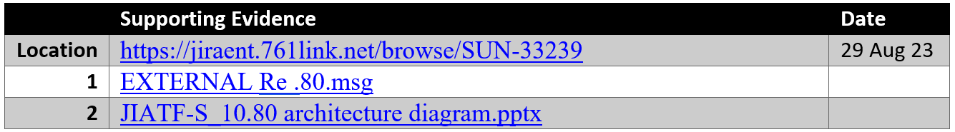
Change Request SNU-33239
SNU-33239 - JIATF-S_TURN ON 10.80 VM_29AUG2023_TESTING_ZONE B_TRITON
Description: The JIATF-S Technical Monitor is requesting we turn back on the 10.80 VM so they can do testing for compatibility of WebTAS with the latest version of Helios. Requesting approval since this VM had log4j showing up on the scans. Once turned back on, the <SYSTEM NAME> team will request scans and complete patching before giving JIATF-S access to do their testing.
The testing will only take 2 days and once their testing is over, the <SYSTEM NAME> team will turn the VM back off.
NSI Rationale:
  Security Impact: This is an SI-M due to turning on a VM that has log4j vulnerability to an internal only accessible Zone B environment for JIATF-S.
  Mitigation: This is mitigated limiting access to JIATF-S Zone B only. This system will be brought and patched prior to turning over to JIATF-S for testing. The test period will be for 48 hours. Total time of system being turned on is 7 days.
BOE:
EXAMPLE

Slide 51
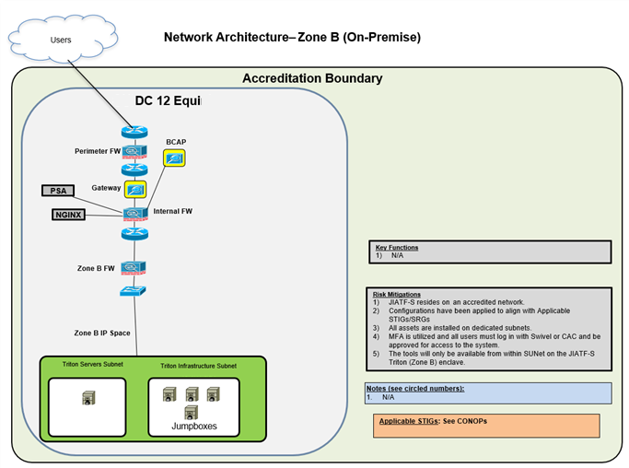
Change Request SNU-33239
EXAMPLE

Slide 52
Change Request SNU-33209
SNU-33209 - US BLUE WHITELIST USA USER.
Description of Change:
  Approver Billet: IDCC J-6 Branch Lead.
  Approval Org: IDCC.
  Mission Urgency: High.
  Physical Location of Individual Accessing US Blue (By Country): Germany.
  Method of Connection: USA Laptop.
  IP Address: 52.61.201.171.
  Link to ARIN lookup: https://search.arin.net/rdap/?query=52.61.201.171.
  Duration if Applicable: 1 year.
Purpose (Justification): USA user needs access.
Duration if Applicable: 1 year.
Description: USA user needs access in support of IDCC/SAG-U.
SI-M Rationale:
  Security Impact: Opening of external access to commercial IPs.
  Mitigation: Implementation of multiple OWASP technics being detected within the Azure WAG, Traffic monitoring through the IAP/BCAP, and monitoring by Splunk/Azure Sentinel and the US Blue SOC.
BOE: https://jiraent.761link.net/browse/SNU-33209.
EXAMPLE

Slide 53
Change Request SNU-33135
SNU-33135 - US BLUE WHITELIST NORWEGIAN USER.
Description of Change:
  Approver Billet: IDCC J-6 Branch Lead.
  Approval Org: IDCC.
  Mission Urgency: High.
  Physical Location of Individual Accessing US Blue (By Country): Germany.
  Method of Connection: NOR Laptop.
  IP Address: 58.112.20.144
  Link to ARIN lookup: https://search.arin.net/rdap/?query=158.112.20.144.
  Purpose (Justification): NOR LNO in IDCC requires access, but their VPN changed.
  Duration if Applicable: 1 year.
  Description: NOR LNO supporting IDCC requires access from Germany, changed VPN.
Link to ARIN lookup:
  https://search.arin.net/rdap/?query=158.112.20.144.
Purpose (Justification): NOR LNO supporting IDCC requires access from Germany, changed VPN.
Duration if Applicable: 1 year.
SI-M Rationale:
  Security Impact: This is an SI-M due to opening of external access to an additional IP.
  Mitigation: This is mitigated by implementation of multiple OWASP technics being detected within the Azure WAG, Traffic monitoring through the IAP/BCAP, and monitoring by Splunk/Azure Sentinel and the US Blue SOC.
BOE: https://jiraent.761link.net/browse/SNU-33135.
EXAMPLE

